Slide 1
Neon Orange

Slide 2
Game overview
Neon Orange is a 2D action skating game, where you skate through a neon city-scape and perform tricks. The gameplay will be a mix between finesse based platforming, and high speed manoeuvring
Platform: Pc and console
Genre: Action platformer
No. of players: 1

Slide 3
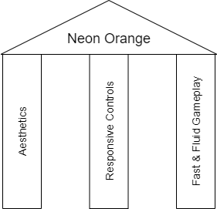
Game pillars
Neon Orange
Aesthetic
Art, music, and gameplay all in sync
Responsive Controls
Very important to the genre and makes the game fun
Fast & Fluid Gameplay
Key to the core experience
Aesthetics
Responsive Controls
Fast & Fluid Gameplay

Slide 4
Unique Selling Point
Combination of fast paced action and precise platforming without ruining the pace of the game
Similar to Sonic but a more even balance of speed and platforming

Slide 5
Platform
Game would be released digitally on:
Consoles
Game is played with a controller
Pc
Larger indie market
Can hook a controller up or play keyboard

Slide 6
Target market
People who like platformers and other intricate skill based games
Impact on design:
It means the game has to have
Tight controls
Replayability

Slide 7
Mechanics & rules
Mechanics
Full control in air for landing and tricks
Can boost to speed up or fly through the air
Can wall jump
Rules
Hitting an obstacle makes you fail
You win when reaching the end of the stage

Slide 8
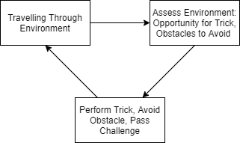
Loops
Being a fast paced game, the loop is happening very quickly

Slide 9
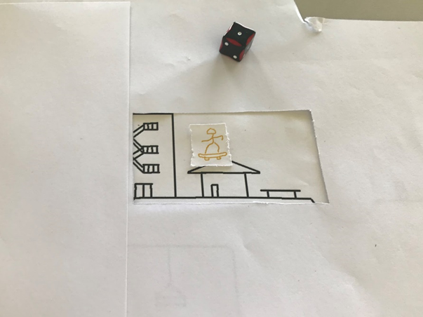
Initial Prototype
The map was covered
Could jump anywhere
Using D6
Rolls a 1 – fails
Rolls a 6 – does trick
100 points for trick

Slide 10
Results of prototype
It was successful in being fast paced but:
Did not reflect the game
Was completely up to chance
Was not guided enough.

Slide 11
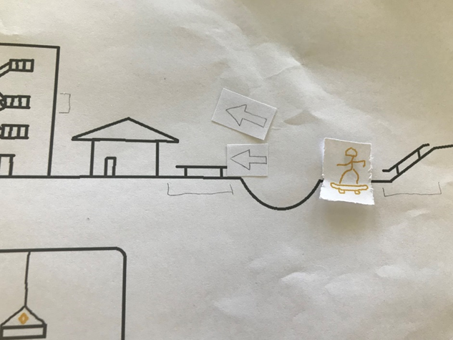
Iteration 1
Map was revealed to player
Branching points and trick locations were indicated
Performing tricks now optional
100 points for trick and 200 for another one in succession

